Slide 1

Week 12b –ch15 Quantitative Data Analysis: Hypothesis Testing
Masters of Information Systems & Technology
MIS 6220 RESEARCH METHODS
_{BY}
Prof. Jimmy K.N.Macharia,
Associate Professor of Information Systems &Technology, and
Dean, School of Science & Technology,
_{kmacharia@usiu.ac.ke}

Slide 2
Type I Errors, Type II Errors and Statistical Power
Type I error (α): the probability of rejecting the null hypothesis when it is actually true.
Type II error (β): the probability of failing to reject the null hypothesis given that the alternative hypothesis is actually true.
Statistical power (1 - β): the probability of correctly rejecting the null hypothesis.

Slide 3
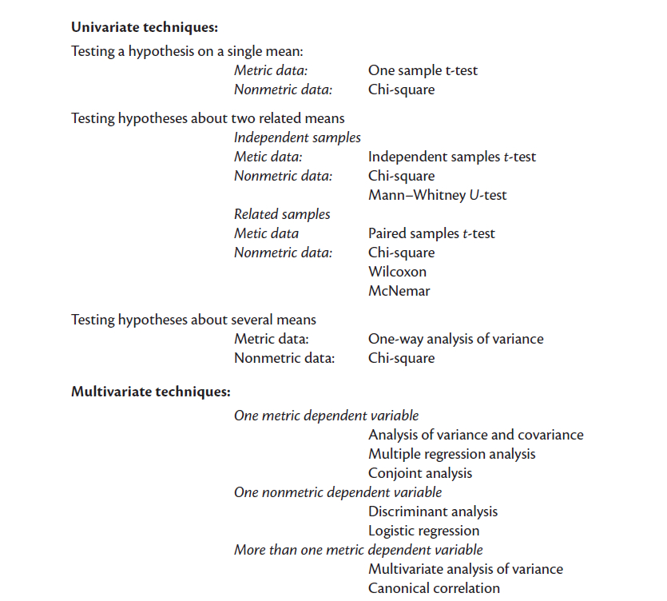
Choosing the Appropriate Statistical Technique

Slide 4
Testing Hypotheses on a Single Mean
One sample t-test: statistical technique that is used to test the hypothesis that the mean of the population from which a sample is drawn is equal to a comparison standard.

Slide 5
Testing Hypotheses about Two Related Means
Paired samples t-test: examines differences in same group before and after a treatment.
The Wilcoxon signed-rank test: a non-parametric test for examining significant differences between two related samples or repeated measurements on a single sample. Used as an alternative for a paired samples t-test when the population cannot be assumed to be normally distributed.

Slide 6
Testing Hypotheses about Two Related Means - 2
McNemar's test: non-parametric method used on nominal data. It assesses the significance of the difference between two dependent samples when the variable of interest is dichotomous. It is used primarily in before-after studies to test for an experimental effect.

Slide 7
Testing Hypotheses about Two Unrelated Means
Independent samples t-test: is done to see if there are any significant differences in the means for two groups in the variable of interest.

Slide 8
Testing Hypotheses about Several Means
ANalysis Of VAriance (ANOVA) helps to examine the signiﬁcant mean differences among more than two groups on an interval or ratio-scaled dependent variable.

Slide 9
Regression Analysis
Simple regression analysis is used in a situation where one metric independent variable is hypothesized to affect one metric dependent variable.

Slide 10
Scatter plot

Slide 11
Simple Linear Regression
Y
?
1
`0
X

Slide 12
Ordinary Least Squares Estimation
Y_{i}
ˆ
e_{i}
Y_{i}
X_{i}

Slide 13
SPSS
Analyze  Regression  Linear

Slide 14
SPSS cont’d

Slide 15
Model validation
Face validity: signs and magnitudes make sense
Statistical validity:
Model fit: R²
Model significance: F-test
Parameter significance: t-test
Strength of effects: beta-coefficients
Discussion of multicollinearity: correlation matrix
Predictive validity: how well the model predicts
Out-of-sample forecast errors

Slide 16
SPSS

Slide 17
Measure of Overall Fit: R²
R² measures the proportion of the variation in y that is explained by the variation in x.
R² = total variation – unexplained variation
total variation
R² takes on any value between zero and one:
R² = 1: Perfect match between the line and the data points.
R² = 0: There is no linear relationship between x and y.

Slide 18
SPSS
= r(Likelihood to Date, Physical Attractiveness)

Slide 19
Model Significance
H₀: β₀ = β₁ = ... = β_{m} = 0 (all parameters are zero)
H₁: Not H₀

Slide 20
Model Significance
H₀: β₀ = β₁ = ... = β_{m} = 0 (all parameters are zero)
H₁: Not H₀
Test statistic (k = # of variables excl. intercept)
F = (SS_{Reg}/k) ~ F_{k, n-1-k}
(SS_{e}/(n – 1 – k)
SS_{Reg} = explained variation by regression
SS_{e} = unexplained variation by regression

Slide 21
SPSS

Slide 22
Parameter significance
Testing that a specific parameter is significant (i.e., β_{j} ≠ 0)
H₀: β_{j} = 0
H₁: β_{j} ≠ 0
Test-statistic: t = b_{j}/SE_{j} ~ t_{n-k-1}
with b_{j} = the estimated coefficient for β_{j}
SE_{j} = the standard error of b_{j}

Slide 23
SPSS cont’d

Slide 24
Conceptual Model
+
Likelihood
to Date
Physical Attractiveness

Slide 25
Multiple Regression Analysis
We use more than one (metric or non-metric) independent variable to explain variance in a (metric) dependent variable.

Slide 26
Conceptual Model
Perceived Intelligence
+
+
Likelihood
to Date
Physical Attractiveness

Slide 28
Conceptual Model
Gender
Perceived Intelligence
+
+
+
Likelihood
to Date
Physical Attractiveness

Slide 29
Moderators
Moderator is qualitative (e.g., gender, race, class) or quantitative (e.g., level of reward) that affects the direction and/or strength of the relation between dependent and independent variable
Analytical representation
Y = ß₀ + ß₁X₁ + ß₂X₂ + ß₃X₁X₂ with Y = DV X₁ = IV X₂ = Moderator

Slide 31
interaction significant effect on dep. var.

Slide 32
Conceptual Model
Gender
Perceived Intelligence
+
+
+
Likelihood
to Date
Physical Attractiveness
+
+
Communality of Interests
Perceived Fit

Slide 33
Mediating/intervening variable
Accounts for the relation between the independent and dependent variable
Analytical representation
Y = ß₀ + ß₁X => ß₁ is significant
M = ß₂ + ß₃X => ß₃ is significant
Y = ß₄ + ß₅X + ß₆M => ß₅ is not significant => ß₆ is significant
With Y = DV
X = IV
M = mediator

Slide 34
Step 1

Slide 35
Step 1 cont’d
significant effect on dep. var.

Slide 36
Step 2

Slide 37
Step 2 cont’d
significant effect on mediator

Slide 38
Step 3

Slide 39
Step 3 cont’d
insignificant effect of indep. var on dep. Var.
significant effect of mediator on dep. var.

